Slide 1


Car Dealership database Management System
Yuktha Lakshmi Arcot Badrinath

Slide 2

Project Overview
In this project, we are building a database management system for a car dealership
Through our system, a car dealership will be able to
Manage records of cars available for selling
Manage records of users who are buying and selling cars through the dealership
Help buyers find cars matching their preferences
Buyers will be able to place bids on cars that they are interested in
Notes:
Within range , sedan examples

Slide 3

COMING UP
Entity relationship data requirements
Conceptual model
Logical model
SQL CODE
USE CASES

Slide 4
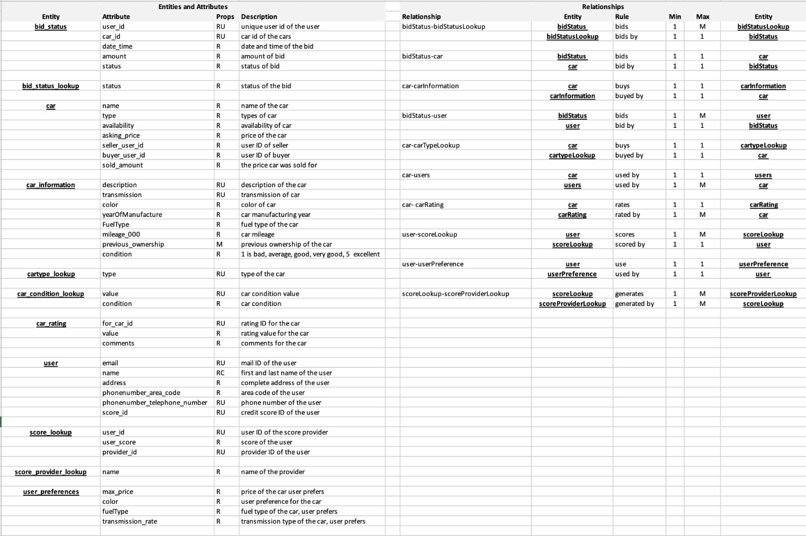
Entity relationship data requirements

Slide 5
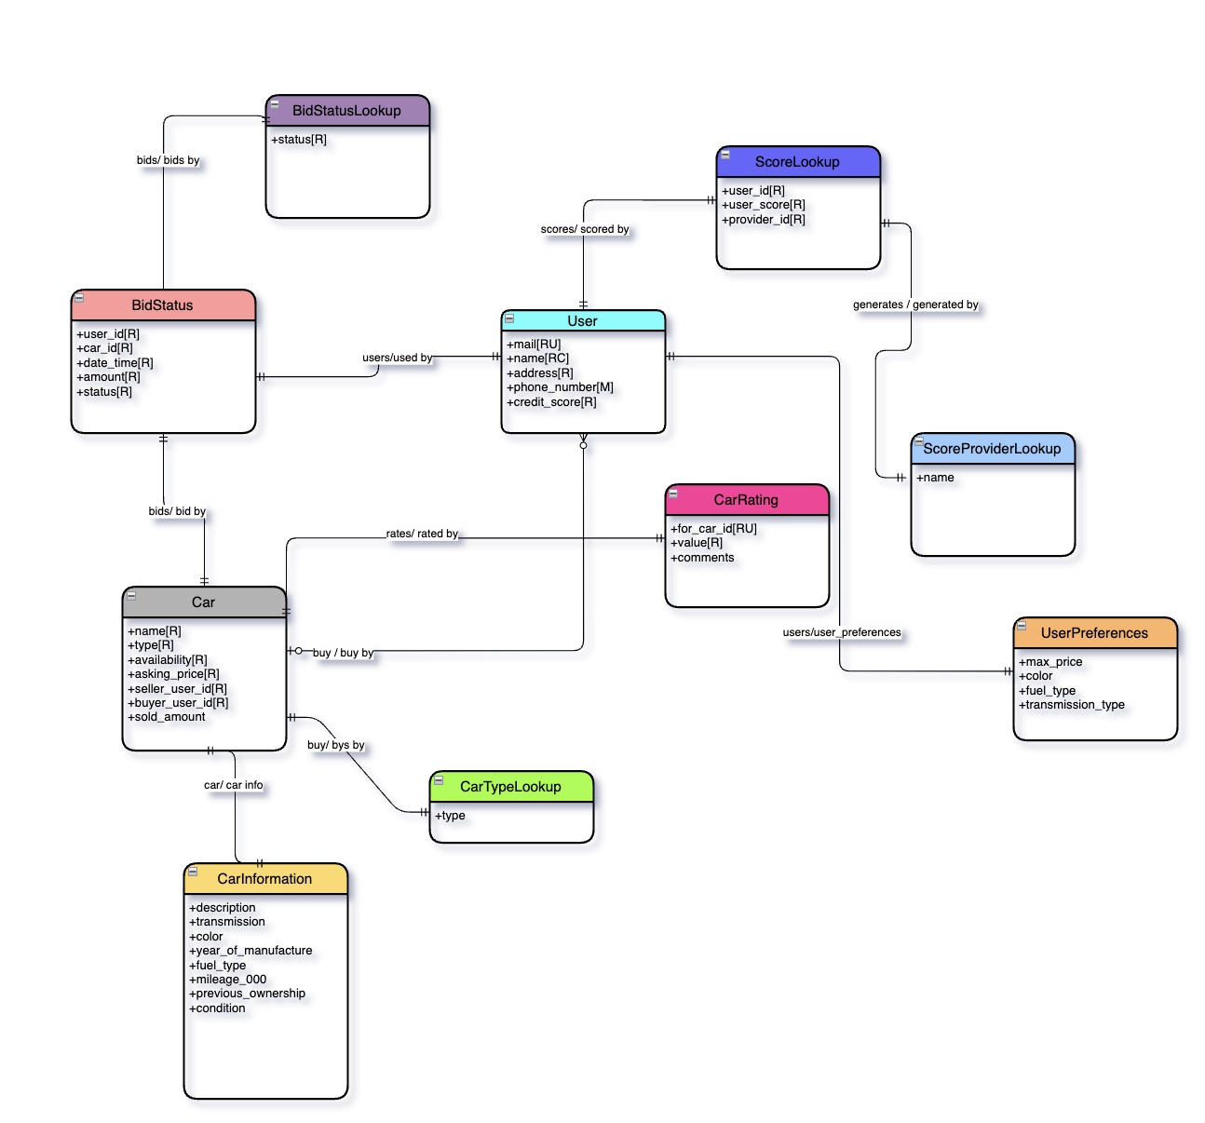

Conceptual model

Slide 6
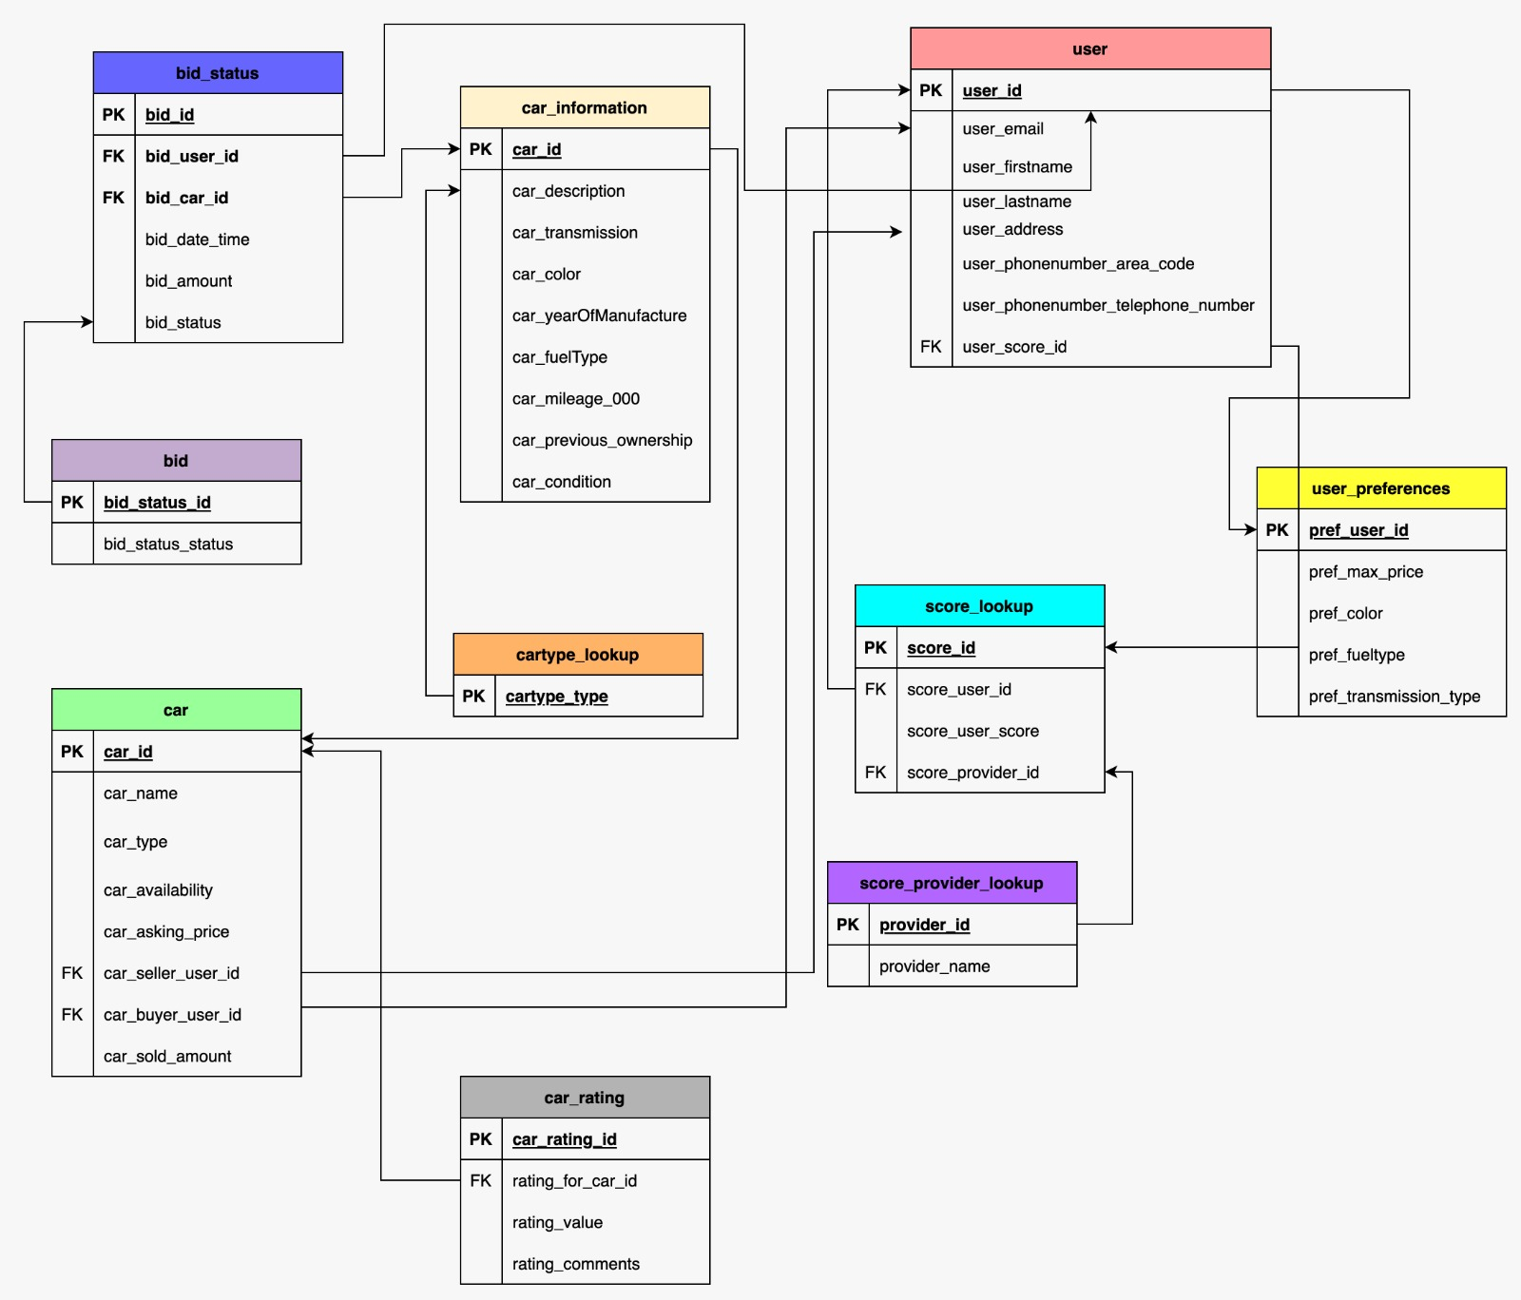
Logical Model

Slide 7

SQL Code
Design Choices
Assumptions

Slide 8
Use cases
User screens
List all available cars
List all the bids on a particular available car
List all the cars matching search criteria
Admin
Filter users by credit score
List all the user preference for particular user

Slide 9
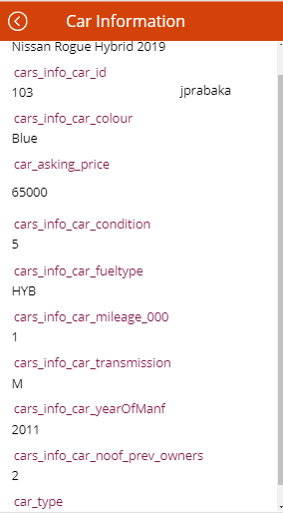
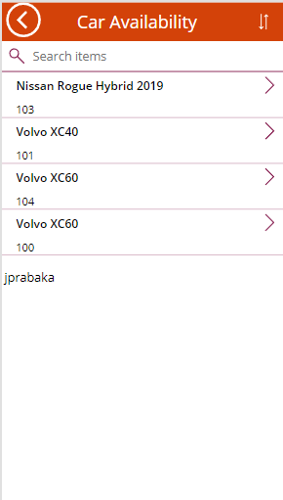
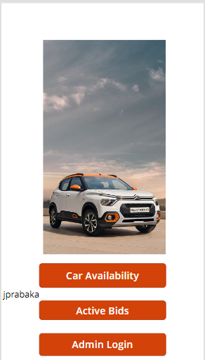
Use Case 1:

Slide 10
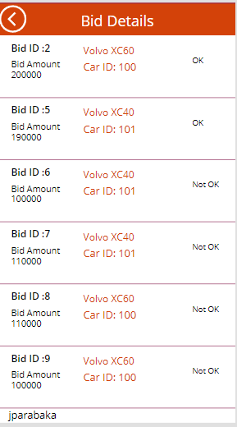
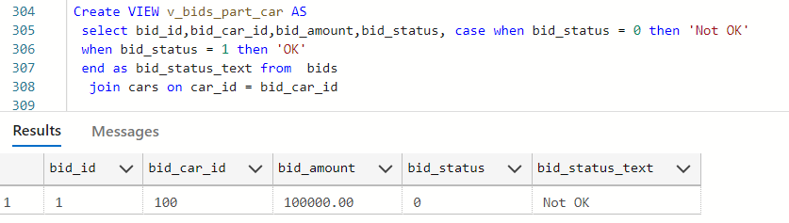
Use Case 2:

Slide 11
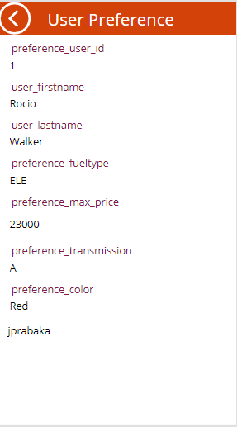
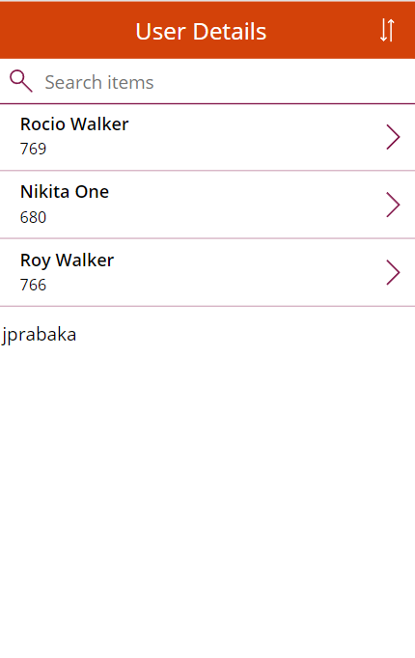
Use Case 3:

Slide 12
THANK YOU

